Slide 1
Object-Oriented and
Classical Software Engineering
Stephen R. Schach srs@vuse.vanderbilt.edu

Slide 2
OBJECT-ORIENTED ANALYSIS

Slide 3
Overview
Object-oriented analysis
Use-case modeling
Class modeling
Dynamic modeling
Challenges of the object-oriented analysis phase

Slide 4
Object-Oriented Paradigm
Object consists of
  Data (attributes, state variables, instance variables, fields, data members), and
  Actions (methods, member functions)
Objects are independent units
  Conceptual independence
  Physical independence

Slide 5
Object-Oriented Analysis (contd)
Semi-formal specification technique
Multiplicity of different methods
  Booch
  OMT
  Objectory
  Shlaer-Mellor
  Coad-Yourdon
All essentially equivalent
Nowadays, we represent OOA using UML (unified modeling language)

Slide 6
The Three Steps of OOA
1. Use-case modeling
  Determine how the various results are computed by the product (without regard to sequencing)
  Largely action oriented
2. Class modeling (“object modeling”)
  Determine the classes and their attributes
  Purely data-oriented
3. Dynamic modeling
  Determine the actions performed by or to each class
  Purely action-oriented
Iterative process

Slide 7
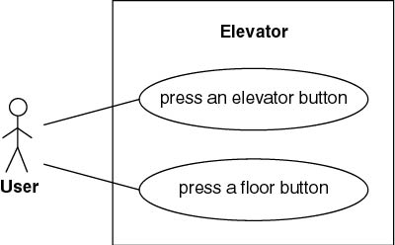
Elevator Problem: OOA
1. Use-Case Modeling
  Use case: Generic description of overall functionality
  Scenario: Instance of a use case
Get comprehensive insight into behavior of product

Slide 8
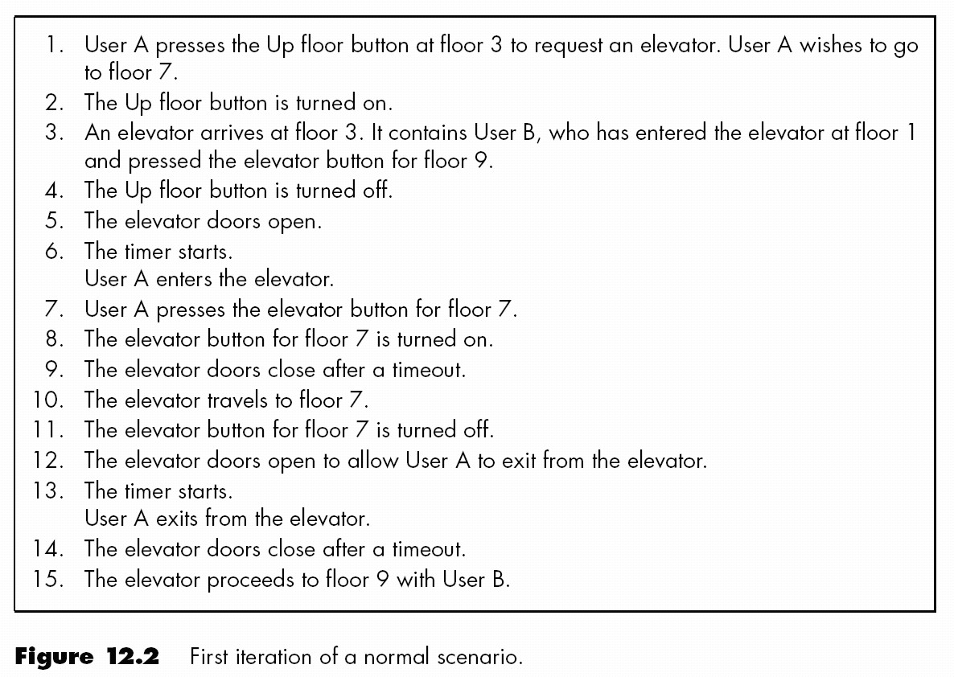
Normal Scenario

Slide 9
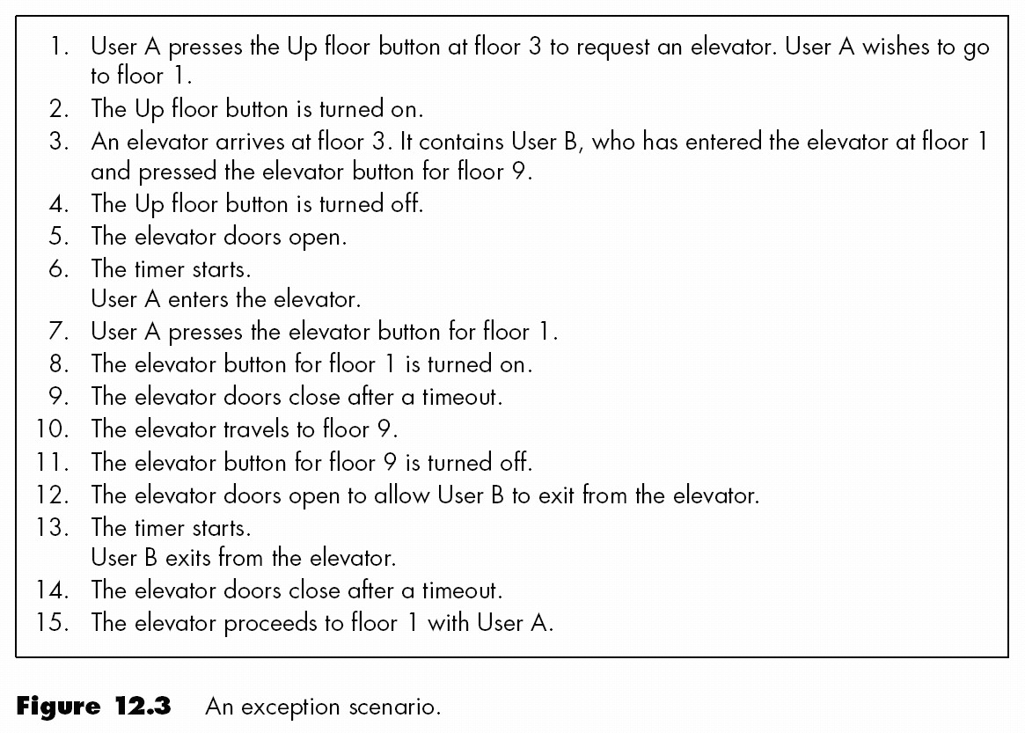
Exception Scenario

Slide 10
Class Modeling
Extract classes and their attributes
Represent them diagramusing an entity-relationship
Deduce the classes from use cases and their scenarios
Often there are many scenarios
  Possible danger: too many candidate classes

Slide 11
Two Approaches to Class Modeling
Noun extraction
  Always works
CRC classes
  Need to have domain expertise

Slide 12
Noun Extraction
Stage 1. Concise Problem Definition
  Define product in single sentence
    Buttons in elevators and on the floors control the motion of n elevators in a building with m floors.

Slide 13
Noun Extraction (contd)
Stage 2. Informal Strategy
  Incorporate constraints, express result in a single paragraph
    Buttons in elevators and on the floors control movement of n elevators in a building with m floors. Buttons illuminate when pressed to request the elevator to stop at a specific floor; illumination is canceled when the request has been satisfied. When an elevator has no requests, it remains at its current floor with its doors closed.

Slide 14
Noun Extraction (contd)
Stage 3. Formalize the Strategy
  Identify nouns in informal strategy. Use nouns as candidate classes
Nouns
  button, elevator, floor, movement, building, illumination, illumination, door
  floor, building, door are outside problem boundary — exclude
  movement, illumination are abstract nouns — exclude (may become attributes)
Candidate classes: Elevator and Button
Subclasses: Elevator Button and Floor Button

Slide 15
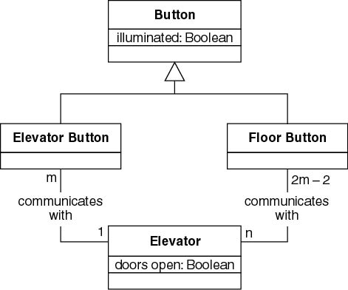
First Iteration of Class Diagram
Problem
  Buttons do not communicate directly with elevators
  We need an additional class: Elevator Controller

Slide 16
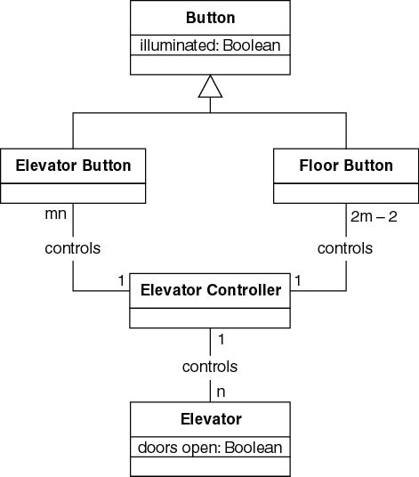
Second Iteration of Class Diagram
All relationships are now 1-to-n
  Makes design and implementation easier

Slide 17
CRC Cards
Used since 1989 for OOA
For each class, fill in card showing
  Name of class
  Functionality (responsibility)
  List of classes it invokes (collaboration)
  Now automated (CASE tool component)
Strength
  When acted out by team members, powerful tool for highlighting missing or incorrect items
Weakness
  Domain expertise is needed

Slide 18
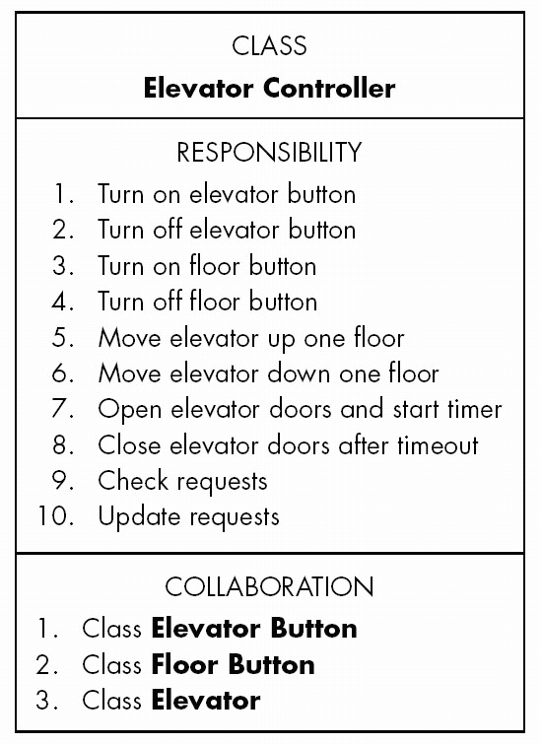
Testing during the OOA Phase
CRC cards are an excellent testing technique

Slide 19
CRC Cards
Consider responsibility
  1. Turn on elevator button
Totally unacceptable for object-oriented paradigm
Responsibility-driven design ignored
Information hiding ignored
Responsibility
  1. Turn on elevator button
should be
  1. Send message to Elevator Button to turn itself on

Slide 20
CRC Cards (contd)
A class has been overlooked
  Elevator doors have a state that changes during execution (class characteristic)
  Add class Elevator Doors
  Safety considerations
Reconsider class model
Then reconsider dynamic model, use-case model

Slide 21
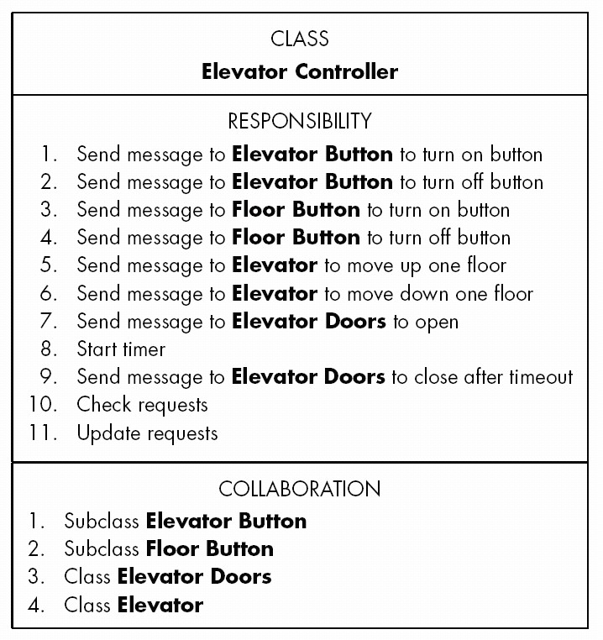
Second Iteration of CRC Card

Slide 22
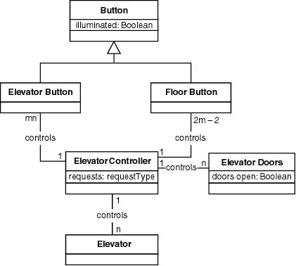
Third Iteration of Class Diagram

Slide 23
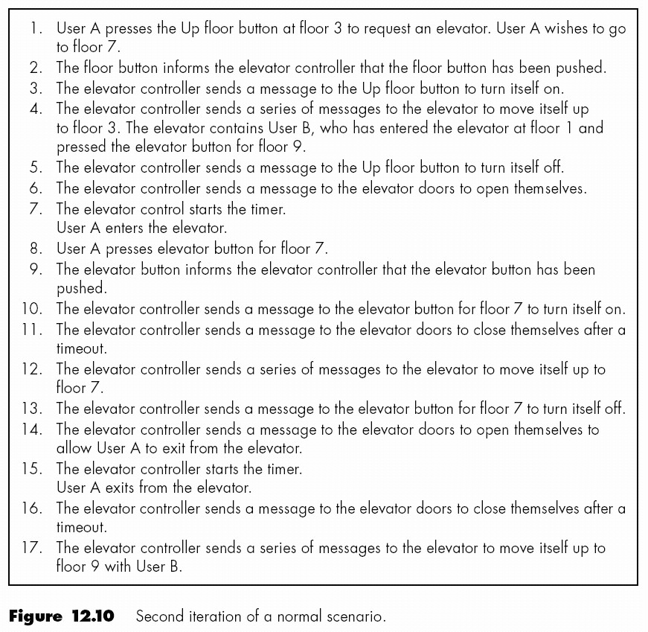
Second Iteration of Normal Scenario

Slide 24
Challenges of the OOA Phase
Do not be eager to jump into object-oriented design
Do not allocate methods to classes yet

Slide 25
DESIGN PHASE

Slide 26
Overview
Elevator problem: object-oriented design

Slide 27
Object-Oriented Design (OOD)
Aim
  Design product in terms of objects extracted during OOA

Slide 28
Object-Oriented Design Steps
OOD consists of four steps:
  1. Construct interaction diagrams for each scenario
  2. Construct the detailed class diagram
  3. Design the product in terms of clients of objects
  4. Proceed to the detailed design

Slide 29
Elevator Problem: OOD
Step 1. Construct interaction diagrams for each scenario
Sequence diagrams
Collaboration diagrams
  Both show the same thing
  Objects and messages passed between them
But in a different way

Slide 30
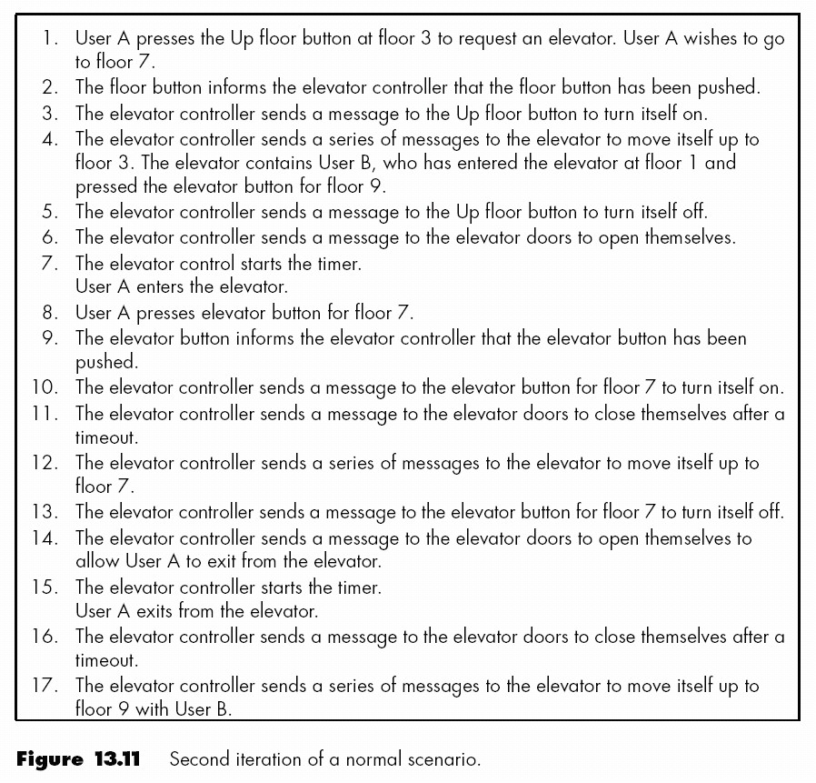
Elevator Problem: OOD (contd)
Normal scenario

Slide 31
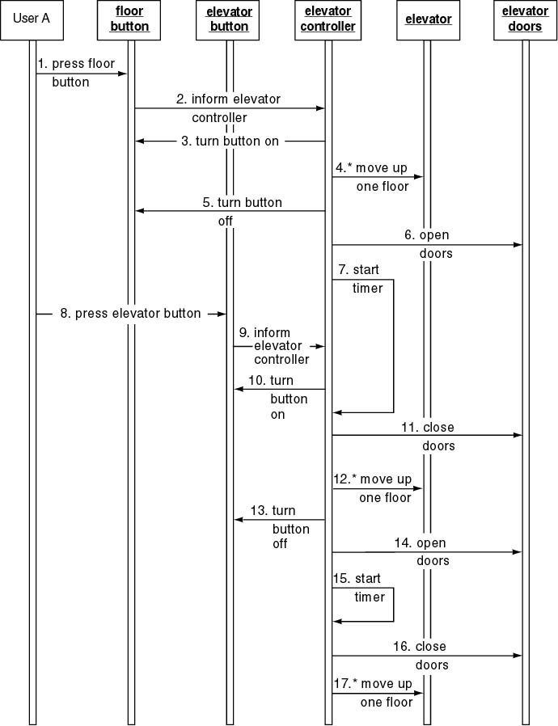
Elevator Problem: OOD (contd)
Sequence diagram

Slide 32
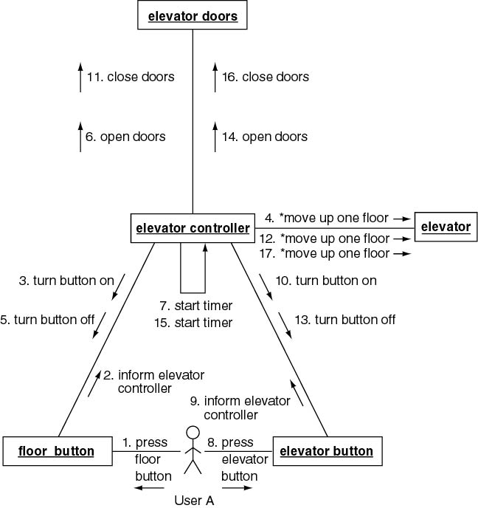
Collaboration diagram

Slide 33
Elevator Problem: OOD (contd)
Step 2. Construct Detailed Class Diagram
Do we assign an action to a class or to a client of that class?
Criteria
  Information hiding
  Responsibility-driven design
Examples
  close doors is assigned to Elevator Doors
  move one floor down is assigned to Elevator

Slide 34
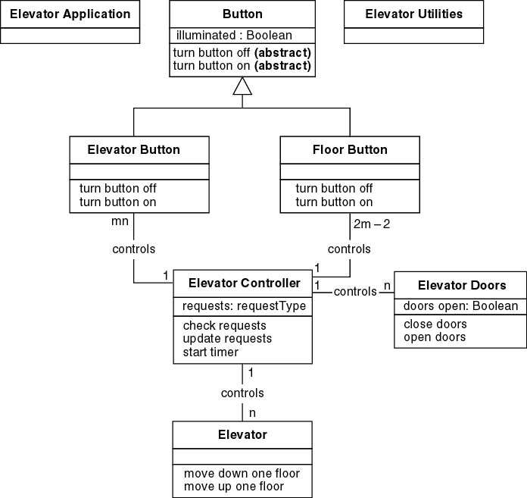
Elevator Problem: OOD (contd)
Detailed class diagram

Slide 35
Elevator Problem: OOD (contd)
Step 3. Design product in terms of clients of objects
Draw an arrow from an object to a client of that object
Objects that are not clients of any object have to be initiated, probably by the main method
  Additional methods may be needed

Slide 36
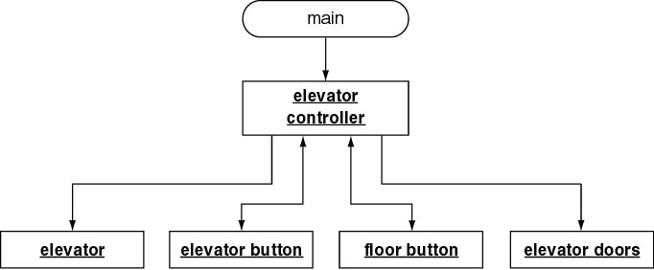
Elevator Problem: OOD (contd)
C++ Client-object relations

Slide 37
Elevator Problem: OOD (contd)
elevator controller needs method elevator control loop so that main (or elevator application) can call it

Slide 38
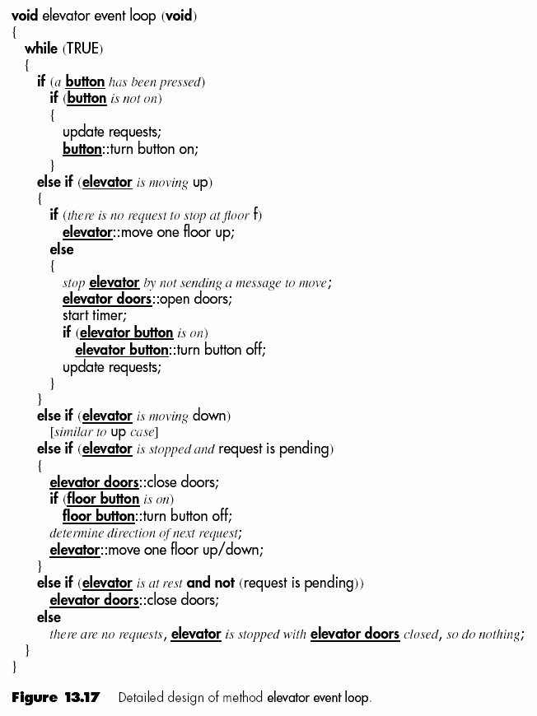
Elevator Problem: OOD (contd)
Step 4. Perform detailed design
Detailed design of method elevator controller loop

Slide 39
Challenges of the Design Phase
Design team should not do too much
  Detailed design should not become code
Design team should not do too little
  It is essential for the design team to produce a complete detailed design

Slide 40
Rational Software Architect - Wikipedia

